Slide 1
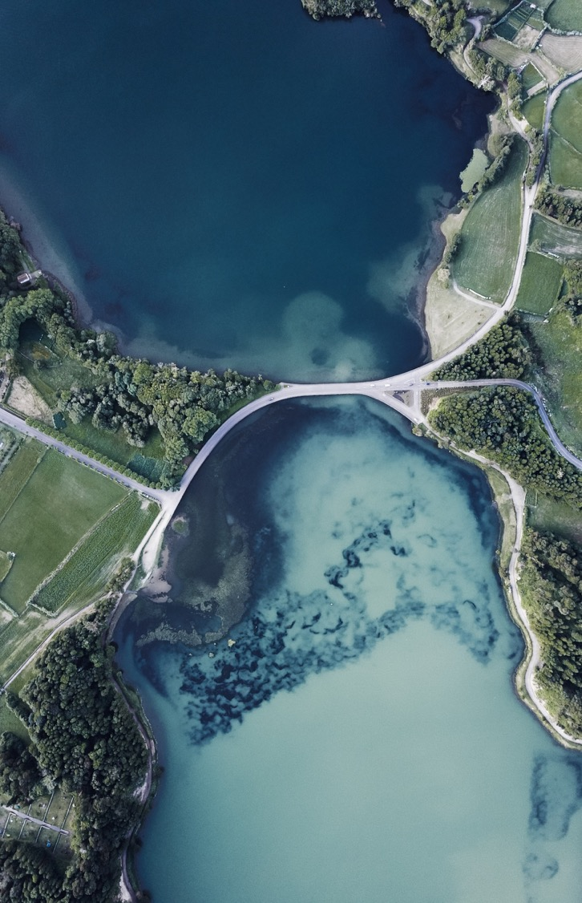
FAST AND EFFICIENT CLUSTER BASED MAP FOR SHIP TRACKING
LUV ARORA – 2021003
A3 Batch
IA - 1

Slide 2



INTRODUCTION
AIS system is implemented on ships to provide geospatial information which can be used to monitor ship position. Such information is used to track ship position and location to avoid collision.
It proposes a fast cluster based method to store and query AIS geospatial information using Redis and also map it as a cluster into a web based map to provide faster and more efficient display.
This approach shows a highly efficient method for ship tracking and also to store and retrieve ship position and efficiently plotting it on a digital map.

Slide 3
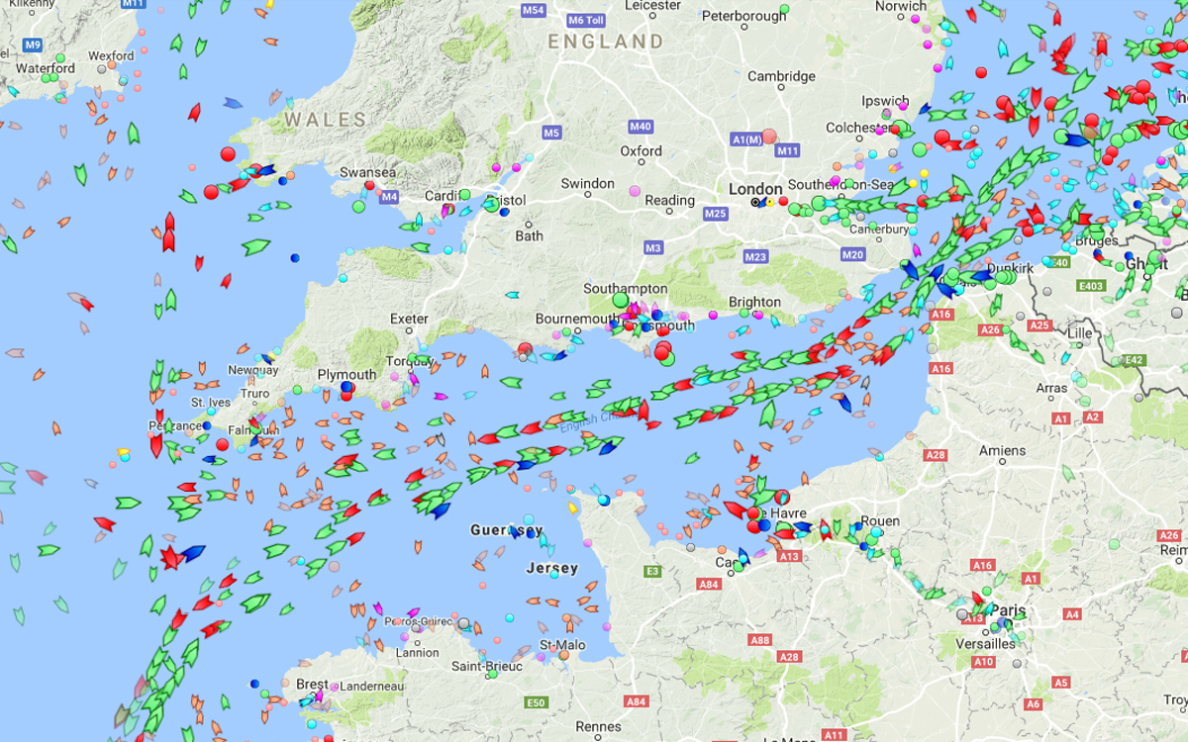
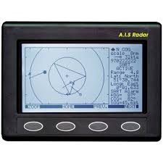
AUTOMATIC IDENTIFICATION SYSTEM
Automatic Identification System is a system designed to improve maritime security by enabling the ship navigator to view the identity, position and direction of other ships nearby. AIS data can be used to monitor ship activities. It sends data simultaneously from multiple ships at very fast intervals.
Static Data
Dynamic Data
Static Data is the information of ship that rarely changes such as ship type, ship name, ship size, call sign and Maritime Mobile Service Identity.
Dynamic Data is the data that continuously changes such as ship position, vessel direction, speed and time.
AIS information can be stored and processed to monitor ship position so it can be used to avoid collision, track ship, predict their track, observe their movement, etc. providing very useful information. Vessels fitted with AIS transceivers can be tracked by AIS base stations located along coast lines or, when out of range of terrestrial networks, through a growing number of satellites that are fitted with special AIS receivers.

Slide 4

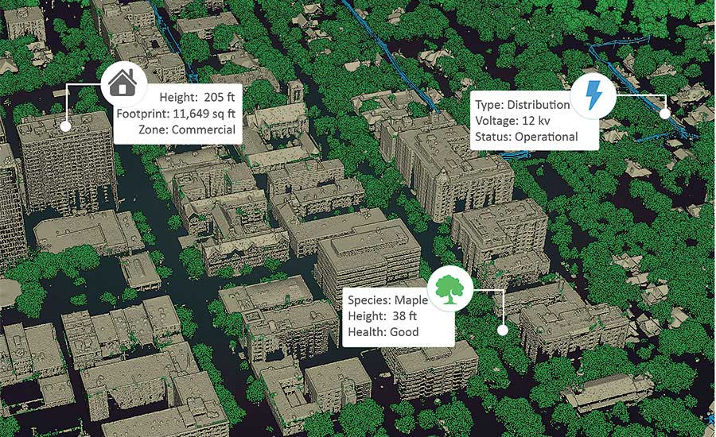
GEOSPATIAL INFORMATION
Geospatial information is data referenced to a place a set of geographic coordinates which can often be gathered, manipulated, and displayed in real time. In recent years consumer demand has skyrocketed for geospatial information and for tools like GIS to manipulate and display geospatial information.
Geographic Information System
Global Positioning System
A digital database in which information is stored by its spatial coordinate system, which allows for data input, storage, retrieval, management, transformation, analysis, reporting, and other activities. GIS is often envisioned as a process as much as a physical entity for data.
A navigation system supported by a constellation of satellites placed in orbit by the U.S. Department of Defense. The satellites transmit precise microwave signals that enable GPS receivers to determine their location, speed, and direction.
Geospatial data: information that identifies the geographic location and characteristics of natural and constructed features and boundaries on Earth.

Slide 5
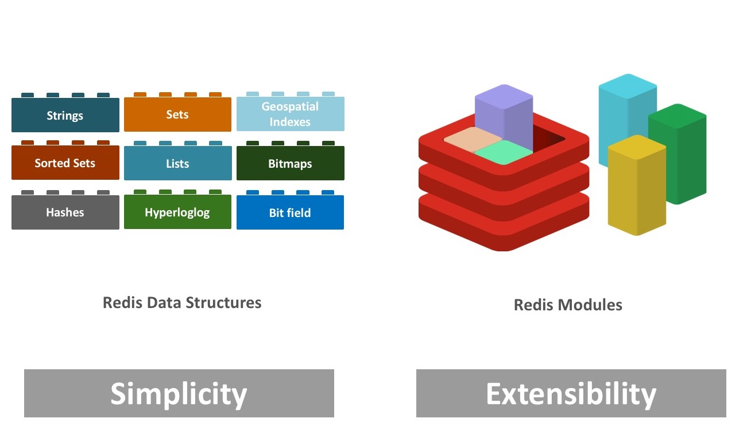

REDIS DATABASE
Redis is an open source, in-memory data structure store, used as a database, cache, and message broker. Redis provides data structures such as strings, hashes, lists, sets, sorted sets with range queries, bitmaps, hyper loglogs, geospatial indexes, and streams. You can run atomic operations on these types, like appending to a string; incrementing the value in a hash; pushing an element to a list; computing set intersection, union and difference; or getting the member with highest ranking in a sorted set.
To achieve top performance, Redis works with an in-memory dataset. Depending on your use case, you can persist your data either by periodically dumping the dataset to disk or by appending each command to a disk-based log. You can also disable persistence if you just need a feature-rich, networked, in-memory cache.
RDBMS
REDIS
RDBMS stores everything in secondary memory.
In RDBMS, Read and Write operations are slow because of storing data in secondary memory.
RDBMS can hold large data which has less frequently usage and not required to be very fast.
Redis stores everything in primary memory.
In Redis, Read and Write operations are extremely fast because of storing data in primary memory.
Redis is used only to store those small textual information which needs to be accessed, modified and inserted at a very fast rate.

Slide 6
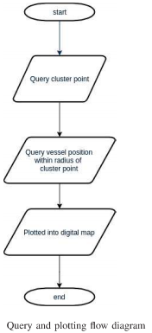
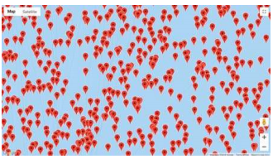
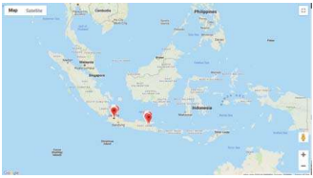
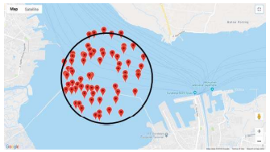
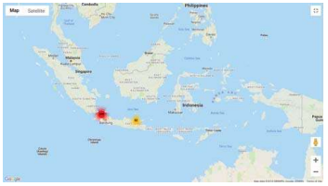
flowchart

Slide 7
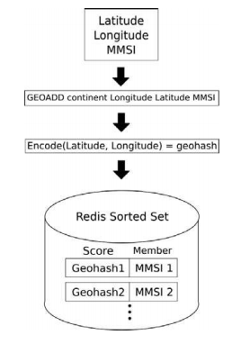





WORKING
STORING SHIP POSITION
STORING CLUSTER POINT
Ships geospatial information in the form of latitude and longitude are stored using REDIS GEOADD which is encoded in geohash(single string).
Geohash is a 52 bit integer and all such hashes are collected into a set.
Continent is used as a key to group ships information based on continent.
Cluster point is a center coordinate of clustering point. This point is stored into a set similar to that of ship position.
Here ZADD command is used to insert cluster point.
Geohash is used as indexing which is calculated by encoding the coordinate into 52 bit geohash.
CLUSTER POINT QUERY
SHIP POSITION QUERY
This is the retrieval process of cluster point within the current view.
ZRANGEBYSCORE is the Redis command used to retrieve the data
GEORADIUS is used to query ship position. Continent is used as a key, cluster point latitude and longitude as center of radius and WITHCOORD parameter to return coordinate from any returned member.

Slide 8
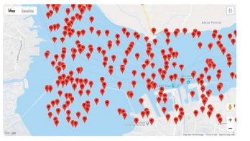
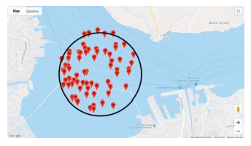
PLOTTING CLUSTERED SHIP INTO MAP
The ships are plotted in a web map using marker. Cluster point query is performed to return any cluster point within current viewing map. Using cluster point we got from previous query, ship position query is performed to retrieve all ship within radius of cluster point. The response from query is then plotted into web map with marker for each data. Next, marker within cluster point is clustered into one big cluster marker. The number on cluster marker shows how many marker it contains. We can zoom into the next level, revealing the next smaller cluster marker with number on the cluster decreases. This can be done until individual ships are shown in the map. Zooming out again the clusters are shown again.

Slide 9
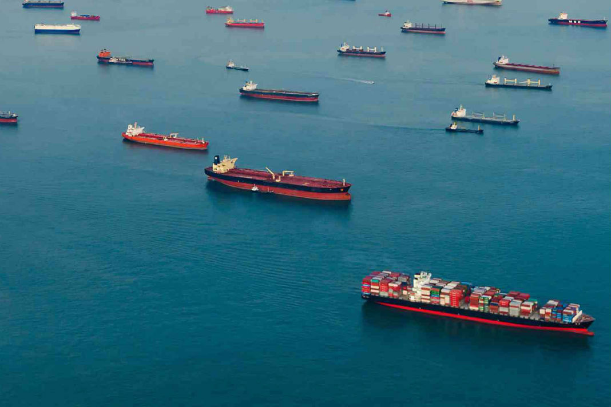
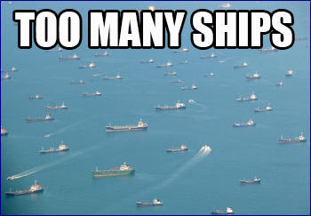
CONCLUSION
We have stored, processed and retrieved ship position sent by AIS using Redis. The cluster point is used to determine the center point of the clustered ship. Then the result ship position query is plotted into the web based map using marker. The data requested by the first user is kept in the memory so reading and writing activity shall be faster. Redis is a memory based cache, the data is first kept in the memory so writing and reading activity is faster.

Slide 10
Bibliography
IEE PAPER LINK:
http://ieeexplore.ieee.org.library.somaiya.edu/stamp/stamp.jsp?tp=&arnumber=8710934
AIS:
https://en.wikipedia.org/wiki/Automatic_identification_system
Geospatial Information: https://www.google.com/url?sa=t&rct=j&q=&esrc=s&source=web&cd=&cad=rja&uact=8&ved=2ahUKEwjFvMPH8srvAhVyzDgGHXcSADoQFjABegQIBBAD&url=https%3A%2F%2Ffas.org%2Fsgp%2Fcrs%2Fmisc%2FR40625.pdf&usg=AOvVaw0u8sx3URHcm2wqPC2wkl8W
REDIS:
https://redis.io/topics/introduction

Slide 11
IMPLEMENTATION STRATEGY
45-50% implementation.
Using already present data for ship location and coastal base station.
Continent will be used as a key.
Will be showing 2 clusters : one densely populated and other less populated.

Slide 12

Thank You
luv.a@somaiya.edu
LUV ARORA - 2021003

